Slide 1





December 03 2021
MINI PROJECT
ATTENDANCE MANAGEMENT SYSTEM
Under the supervision of Dr. Anjali Gautam Mam

Slide 2

GROUP MEMBERS
NAVNEET SINGH IIT2019056
NAVDEEP KUMAR IIT2019082
GAUTAM KUMAR IIT2019087
HARSHAL MESHRAM IIT2019104

Slide 3
Problem Statement
Introduction
Objective
Literature survey
Statistics
Flow chart
Proposed approach
Technologies used
Data collection
Data analysis
implementation
Accuracy
Conclusion
Future Enhancements
References
CONTENT

Slide 4

Problem Statement
The focus of our project is to build an automatic attendance marking system which will mark the attendance of the registered users by identifying them through facial recognition and also note the timing.

Slide 5

Daily attendance marking is a common and important activity in schools/colleges/organizations for checking the performance and working time of students/employees .
Manual Attendance maintenance is a difficult process, especially for large groups of students/employees.
The traditional method of calling the names of the students is very time consuming and there is always a chance of proxy attendance.
This report reviews a different method which can be adopted to reduce the time wasted while taking the attendance.
INTRODUCTION

Slide 6

OBJECTIVE
This project aims to automate the traditional attendance system where the attendance is marked manually.
It also enables an organization to maintain its records like name,date and time.

Slide 7
LITERATURE SURVEY
P. Lad and S. More, “STUDENT ATTENDANCE SYSTEM USING IRIS DETECTION"[8]
Grayscale is simple image in which the only colors are shades of gray.Gray color is one in which the red, green and blue components all have equal intensity.
SSR filter is a rectangle divided into 6 segments, operates by using the concept of bright-dark relation around Between-the-Eyes area to detect the eyes.
In this proposed system the student is requested to stand In the front of the digital camera to come across and recognize the iris, for the system to mark attendance.[8][9]
Some algorithms like Gray Scale Conversion, Six Segment Rectangular Filter(SSR), Skin Pixel Detection are getting used to detect the iris.

Slide 8
LITERATURE SURVEY
Yi-Qing et al,”An Analysis of the Viola-Jones Face Detection Algorithm”[3]
Cascade classifier- It is a ML based approach where a function is trained from a lot of positive images (images of faces) and negative images (images without faces)
A support vector machine (SVM) is a supervised machine learning model that uses classification algorithms for two-group classification problems.
Viola-Jones Algorithm has been used for face detection which detect human faces using a cascade classifier and PCA set of rules for feature choice and SVM for classification.[3][5]

Slide 9

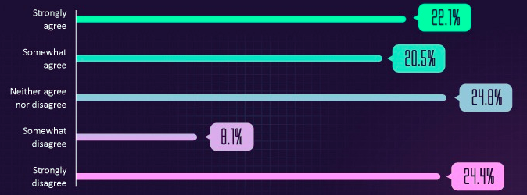
A May 2019 study found that more people approve the use of facial recognition technology at airports than (42.6%) than disapprove (32.5%)
STATISTICS
Source: reservations.com

Slide 10
Statistics
In 2019, facial recognition technology was worth $3.2 billion.
A significant growth from $3.8 billion in 2020. (Markets and Markets, 2020)
The facial recognition market value is expected to reach $8.5 billion by 2025
Source : https://financesonline.com/facial-recognition-statistics/

Slide 11
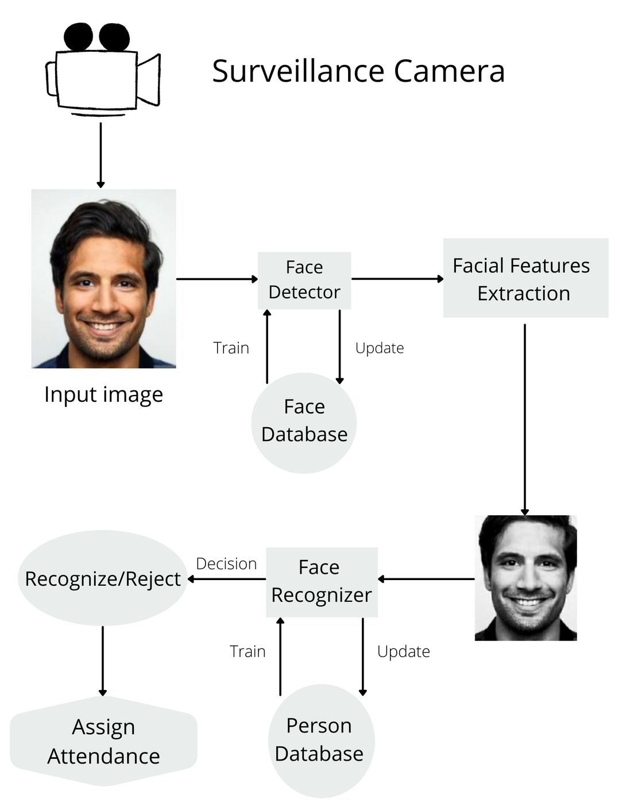
FLOWCHART

Slide 12

PROPOSED APPROACH
Capture the face of each student using OpenCV for taking images and facial recognition.
Store it in the local database.
After the face recognition, the face identification will be done.
In face identification a one-to-many mapping for a given face against a database of known faces will be done
If the captured face found in the database then it’ll mark that student present and note their timings

Slide 13

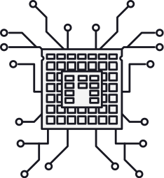


TECHNOLOGIES USED
Preferable Python version<=3.8.0

Slide 14
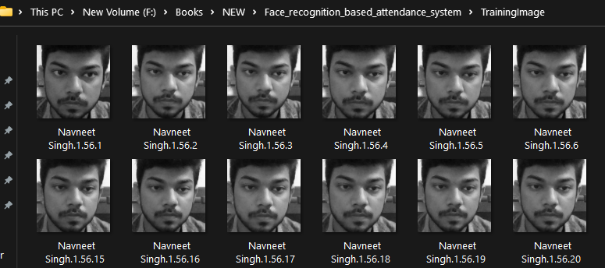
Data Collection
We will take images of users at the time of their registration

Slide 15
Data Analysis
Why?
To make data analysis easier and to mark attendance easily
How?
Using Local binary pattern histogram(LBPH)

Slide 16
Local binary pattern histogram (LBPH)
Face recognition algorithm
Uses data-set of images of the people who need to be recognized.
Each image is given a unique ID as either a number or the name of a person so that the algorithm can use this information to identify the image and export the output.[10][11]

Slide 17
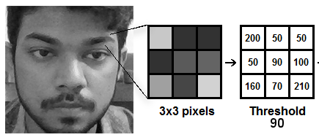
Before understanding LBPH
All images can be represented in the Matrix formats which are composed of rows and columns.
The basic component of an image is the pixel. An image is made up of a set of pixels.
Each one of these is small squares. By placing them side by side, we can form the complete image.

Slide 18
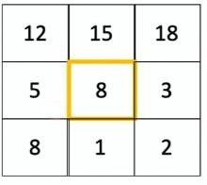
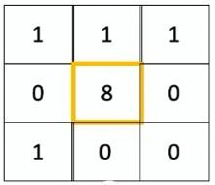
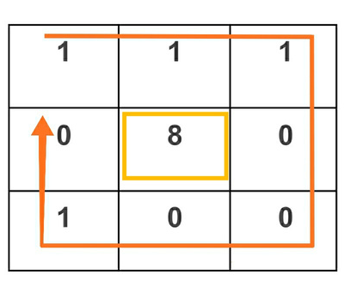
LBPH Working
Steps-
Consider this matrix of an image {fig 1}
Threshold value= central pixel --> 8
Applying a condition that-
set 1 for values >=threshold and
set 0 for values <threshold {fig 2}
selecting the threshold element,generate a binary value as shown in fig 3
Fig. 1.
Fig. 2.
Fig. 3.

Slide 19
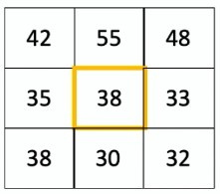
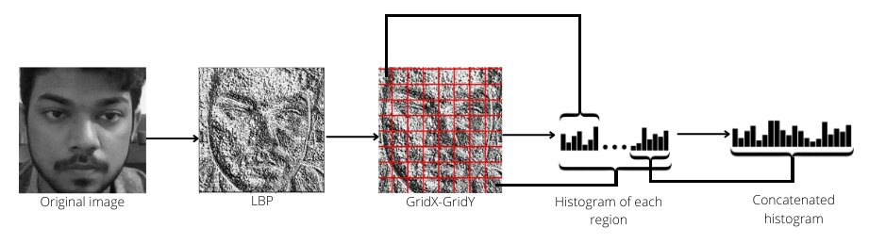
LBPH Working
Steps-
Now convert this binary value to a decimal value and set it to the central value of the matrix {fig 4}
By repeating this procedure with other pixels we'll have a new image which will be more analyzable than previous image {fig 5}
Fig. 4.
Fig. 5.

Slide 20
Extracting histograms
Steps-
Using the image generated in the last step, divide the image into multiple grids
Histogram of the region is created by counting the number of similar pixel values in the region{fig 6}
After creation of histogram for each region all the histograms are merged to form a single histogram{fig 6}
Then,we compare the histograms of the test image and the images in the database and return the image with the closest histogram.
Fig. 6.

Slide 21
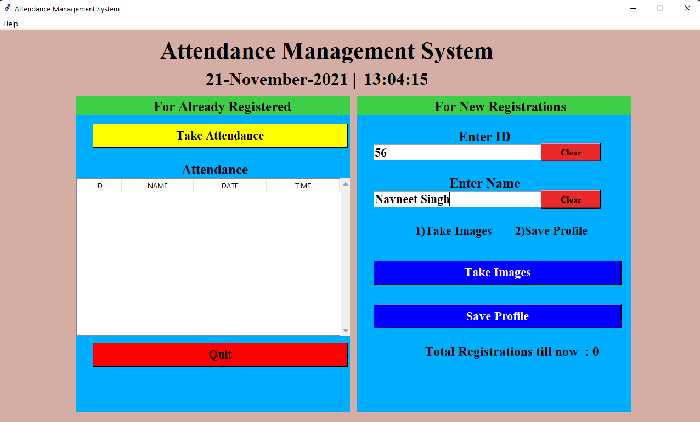
IMPLEMENTATION
Enter Enrollment ID and Name

Slide 22
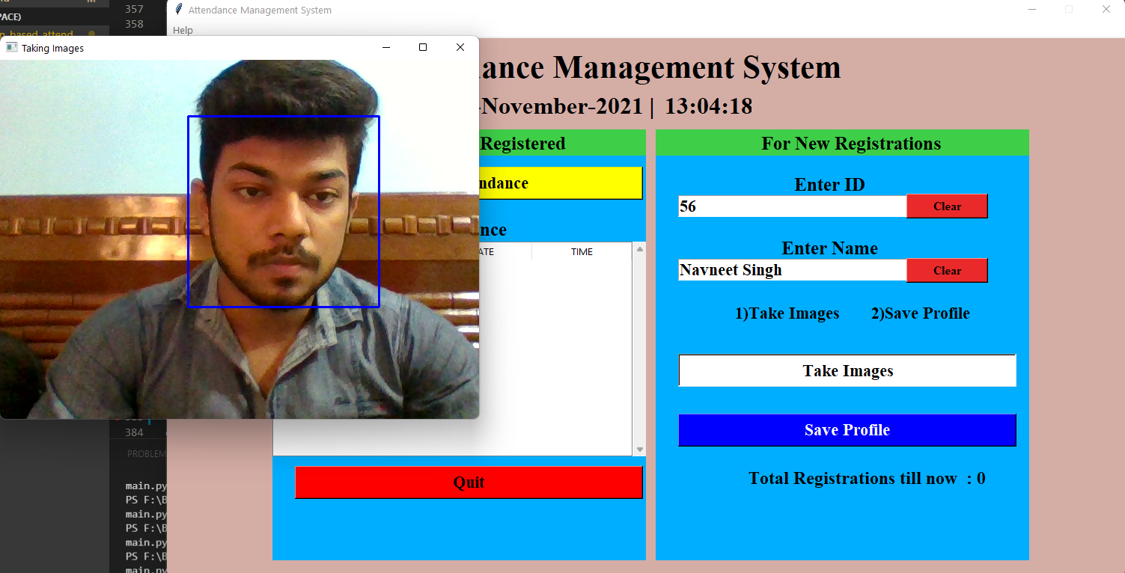
Click on take images option

Slide 23
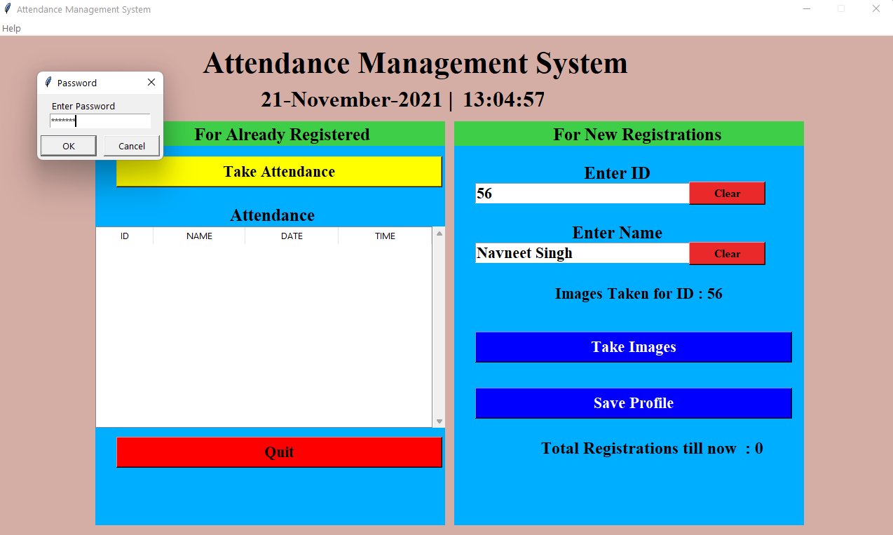
After taking images, click on save profile and enter correct password to save profile

Slide 24

After the profile gets saved the total registration till now gets incremented by 1

Slide 25
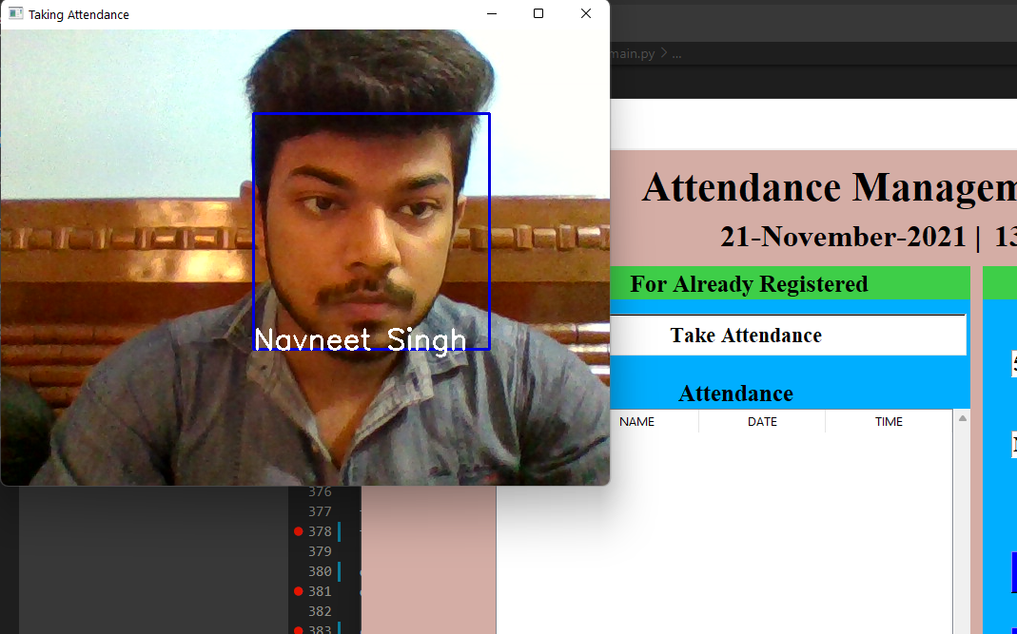
After the profile gets saved click on take attendance button and your face will be recognised

Slide 26

Press 'q' after successful face recognition and your attendance will be recorded and details will be displayed

Slide 27
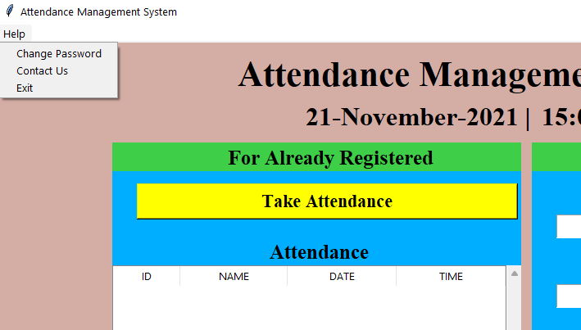
In the help button there are some extra features available

Slide 28
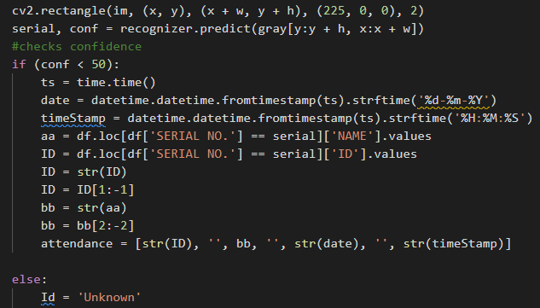
Accuracy
For the accuracy part we have:
Recognizer.predict(gray[y:y+h,x:x+w]) funtion
It returns the prediction index that shows the-
Number of the person in training set
Confidence for it for all persons
The value of confidence usually depends on your data, but the lower the better

Slide 29
CONCLUSION
By using different algorithms and techniques for facial recognition operation the accuracy will increase and the chances of proxy will decrease.
Capturing the images from camera and applying techniques face detection and recognition can decrease the manual work from human and increase the security safety, taking the decision from this recognition result.
In future this project will be enhanced and could be used at those places where we require surveillance like ATMs and banks.
This method will have higher accuracy in recognition of multiple faces from a single frame with lower response time.

Slide 30

This technology can be further developed to be used in other avenues such as ATMs, accessing confidential files, or other sensitive materials.
It can be implemented in large halls like auditoriums to calculate the number of people present there.
it will also be adopted by retailers and banking systems in coming years to keep fraud in debit/credit card purchases and payment especially the ones that are online.
FUTURE ENHANCEMENTS

Slide 31
Nandhini R, Duraimurugan N, S.P.Chokkalingam, ”Face Recognition Based Attendance System”, published in International Journal of Engineering and Advanced Technology (IJEAT), February 2019
[1]
REEFERENCES
Kaneez Laila Bhatti1,Laraib Mughal,Faheem Yar Khuhawar,Sheeraz Ahmed Memon,”Smart Attendance Management System Using Face Recognition”, analysis in Dept. of Telecommunication Engineering, MUET, Jamshoro, PK, 29 October 2018
[2]
Yi-Qing Wang,CMLA, ENS Cachan,”An Analysis of the Viola-Jones Face Detection Algorithm”, published in Image Processing On Line (IPOL), 26 June 2014
[3]
Dhanush Gowda H.L,K Vishal,Keertiraj B. R,Neha Kumari Dubey,Pooja M. R.,”Face Recognition based Attendance System”, analysis in Vidyavardhaka College of Engineering, Mysuru, Karnataka, India,published in International Journal of Engineering and Advanced Technology (IJEAT), 06 June 2020
[4]

Slide 32
Mehul K Dabhi,Bhavna K Pancholi,”Face Detection System Based on Viola - Jones Algorithm”,analysis in M. S. University Baroda, India,published in International Journal of Science and Research (IJSR),4 April 2016
REEFERENCES
[5]
Hajar Filali,Jamal Riffi,Adnane Mohamed Mahraz,Hamid Tairi,”Multiple face detection based on machine learning”,analysis in Department of computer science Faculty of Sciences Dhar-Mahraz Sidi Mohamed Ben Abdellah University,Fez, Morocco.2018
[6]
Venkata Kalyan Polamarasetty,Muralidhar Reddy Reddem,Dheeraj Ravi,Mahith Sai Madala,”Attendance System based on Face Recognition”,published in International Research Journal of Engineering and Technology (IRJET),4 April 2018
[7]
[8]
P. Lad and S. More, “STUDENT ATTENDANCE SYSTEM USING IRIS DETECTION,” no. 2, pp. 3293–3298, 2017.
[9]
https://www.sciencedirect.com/topics/computer-science/iris-recognition

Slide 33
[10]
https://towardsdatascience.com/face-recognition-how-lbph-works-90ec258c3d6b
REEFERENCES
https://www.section.io/engineering-education/understanding-facial-recognition-using-local-binary-pattern-histogram-algorithm/
[11]

Slide 34


